Slide 1
Review Sprint 2 PIVOANE PIéton, Vitesse, dOs d’ANE
OUR TEAM
Sara Bassanetti
Emeline Delhay
Luiz Renato Rodrigues Carneiro
Léa Scheer
Yuchen Xia
TUTORS
Gwendolyne Le Corre
Thierry Monteil
Notes:
Hello,
My name is Luiz Renato …
Our tutors are Gwendolyne Le Corre and Thierry Monteil
This is the presentation of the review 0 with our project plan of the autonomous vehicle project. The name of our project is PIVOANE due to the translation of the words pedestrian, speed, and speed bump in french.

Slide 2






TABLE OF CONTENT
1
3
5
PRODUCT DESCRIPTION
STORIES /
DEMONSTRATIONS
SCHEDULE CONTROL
OBJECTIVES OF SPRINT 2
ORGANISATION OF SPRINT 2
OBJECTIVES / ORGANIZATION OF SPRINT 3
2
2
4
6

Slide 3


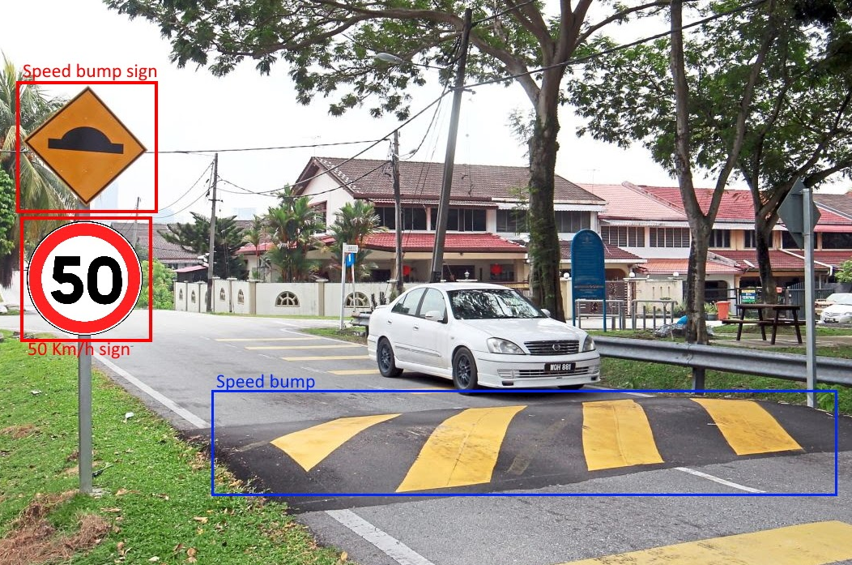

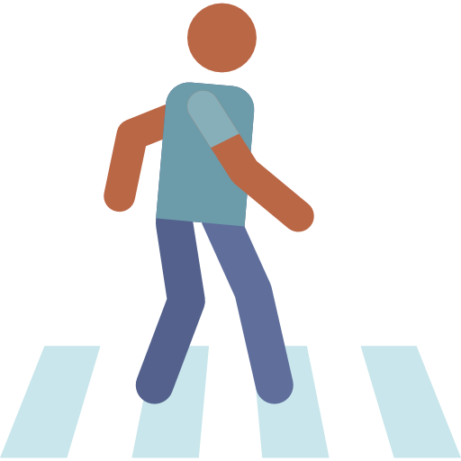
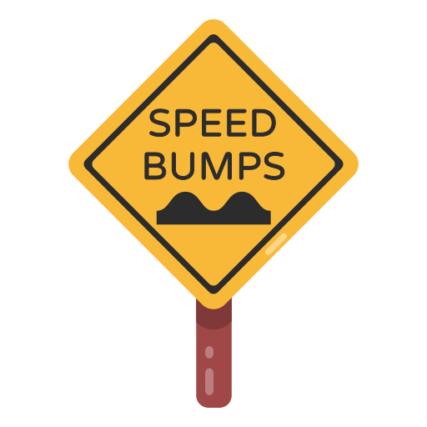


PRODUCT DESCRIPTION
Adapt the car's behavior according to the environment detected in different complex situations
Adjust the speed of the car when a road sign is detected
Stop the car when there are pedestrians on the road
Slow down when approaching a crosswalk or speed bump
3

Slide 4




OBJECTIVES OF SPRINT 2
AI training
Create and train the AI model which detects road signs and pedestrians
Road sign detection
Detect and recognize road signs (especially the stop sign detection)
Obstacles detection
Dectect obstacles on the road (especially pedestrians)
4
4

Slide 5






STORIES / DEMONSTRATIONS
Detect obstacles on the road
Simulate an obstacle on the road in front of the car​
Half speed between 1m and 50cm
Stop the car at 50cm of the obstacle
1m
50 cm
Full Speed
Half Speed
STOP
5
5
Notes:
The first user story we had to achieve was the detection of obstacles on the road using ultrasonic sensors. I worked on it with Emeline. Since we wanted mostly to detect a pedestrian crossing the road, we took an obstacle with a width of approximately 20 centimeters. We defined the values for the test such as when the car detects an obstacle on the road, it drives forward at full speed until it sees it at 1 meter. *** activate the animation *** Once the car is at one meter of the obstacle, it drives half speed until it reaches a distance of 50centimeters . Then it stops. I am going to show you now with a demonstration. ***end of demonstration *** The main use of the ultrasonic sensors is to detect last second pedestrians and obstacles, such as a kid running in front of the car or animals. We can improve this user story by adding the LIDAR detection since it is a lot more precise. This is something we might work on during a future sprint.

Slide 6
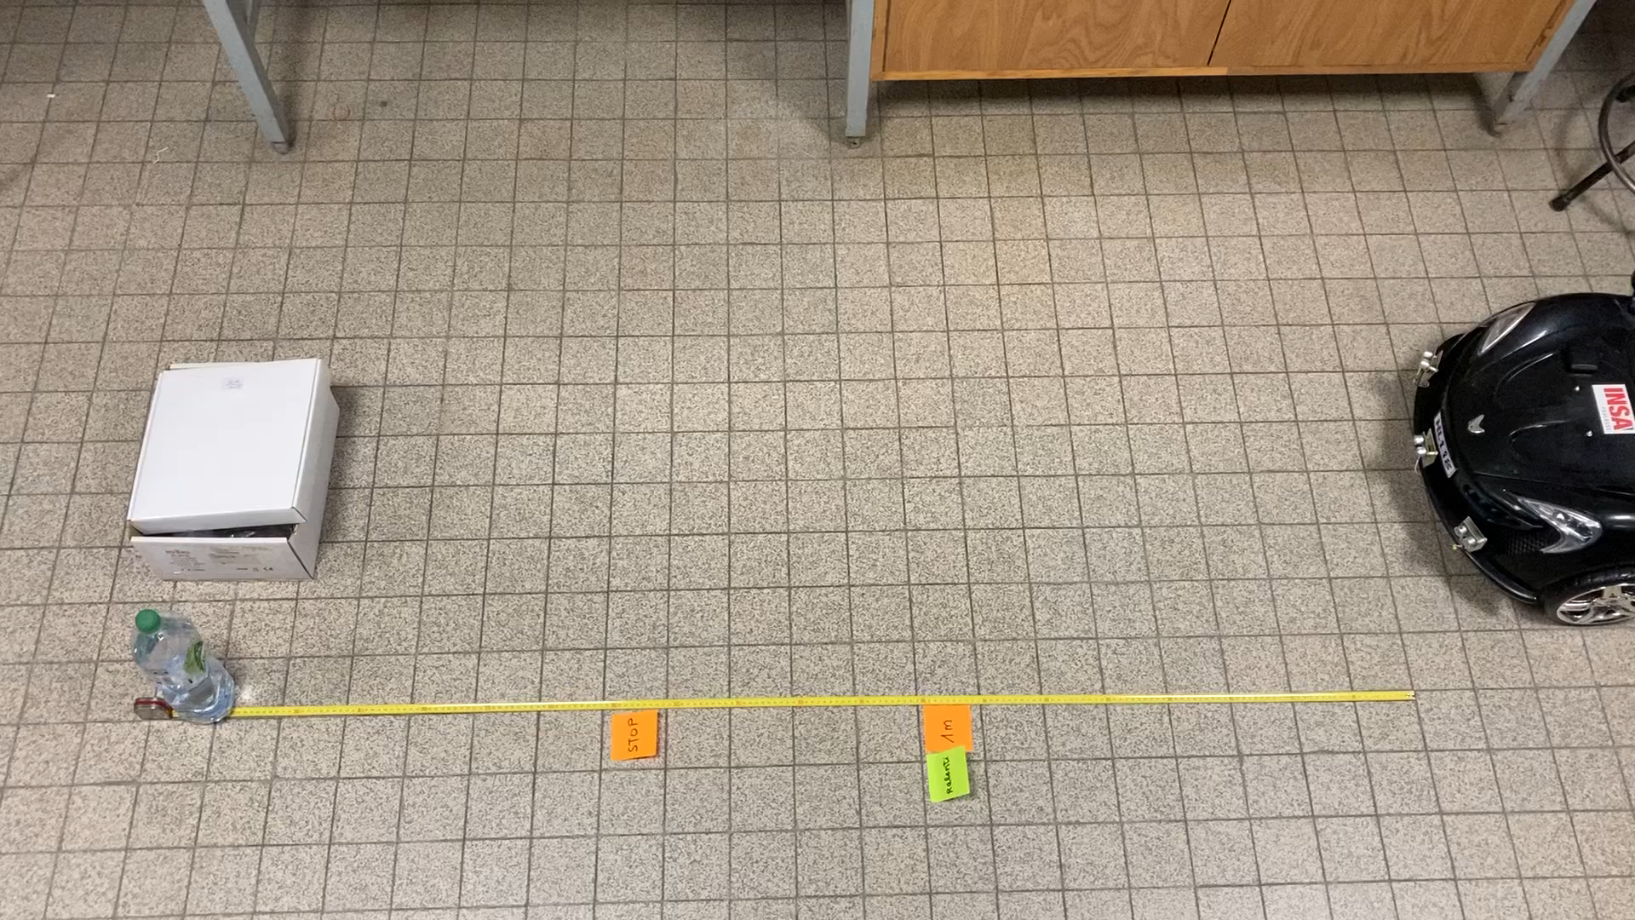
DEMONSTRATION VIDEO (first user story)
6

Slide 7





STORIES / DEMONSTRATIONS
AI training
Collect and pre-process data
Test the accuracy, recall and other indicators of the model
3 classes of detection
7
7
Notes:
The first step to the user story AI training we start to find dataset. For this sprint, we start with coco dataset that is a very useful one. Indeed, it a lot of images to use, in a lot of situation that is really import to have an accurate AI models after training.
Using this one, we had to convert coco data in the yolo data to be able to train AI. We sucssed to implement AI models on stop signs and pedestrian classes and obtains a good accuracy of detection.
We also start to train model with 50speed road sign but for the moment the dataset is not relevant as we want, so we have to improve it to the next sprint to have a better accuracy for the detection.

Slide 8
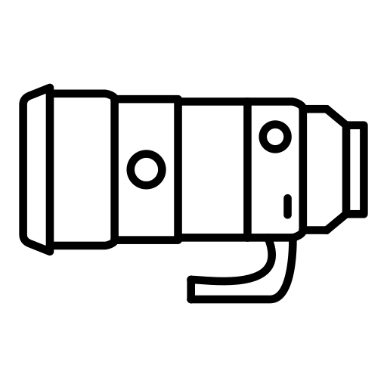
STORIES / DEMONSTRATIONS
AI training on road sign
Place a stop sign on the road in front of the car​
Detect stop sign at most 10 meters away with the camera of the car
Sending the order to stop in less than 3 seconds
10 m
Accuracy over 95%
8

Slide 9
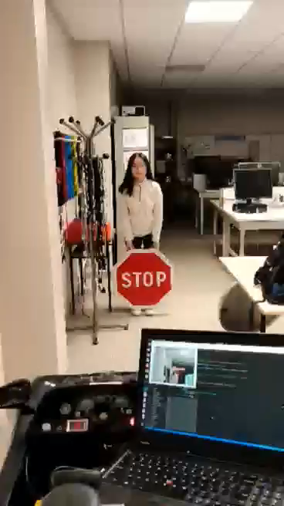
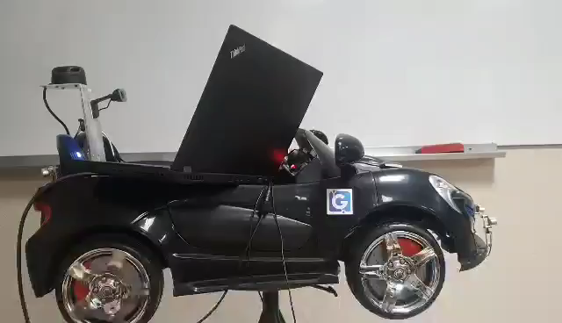
STORIES / DEMONSTRATIONS
9

Slide 10
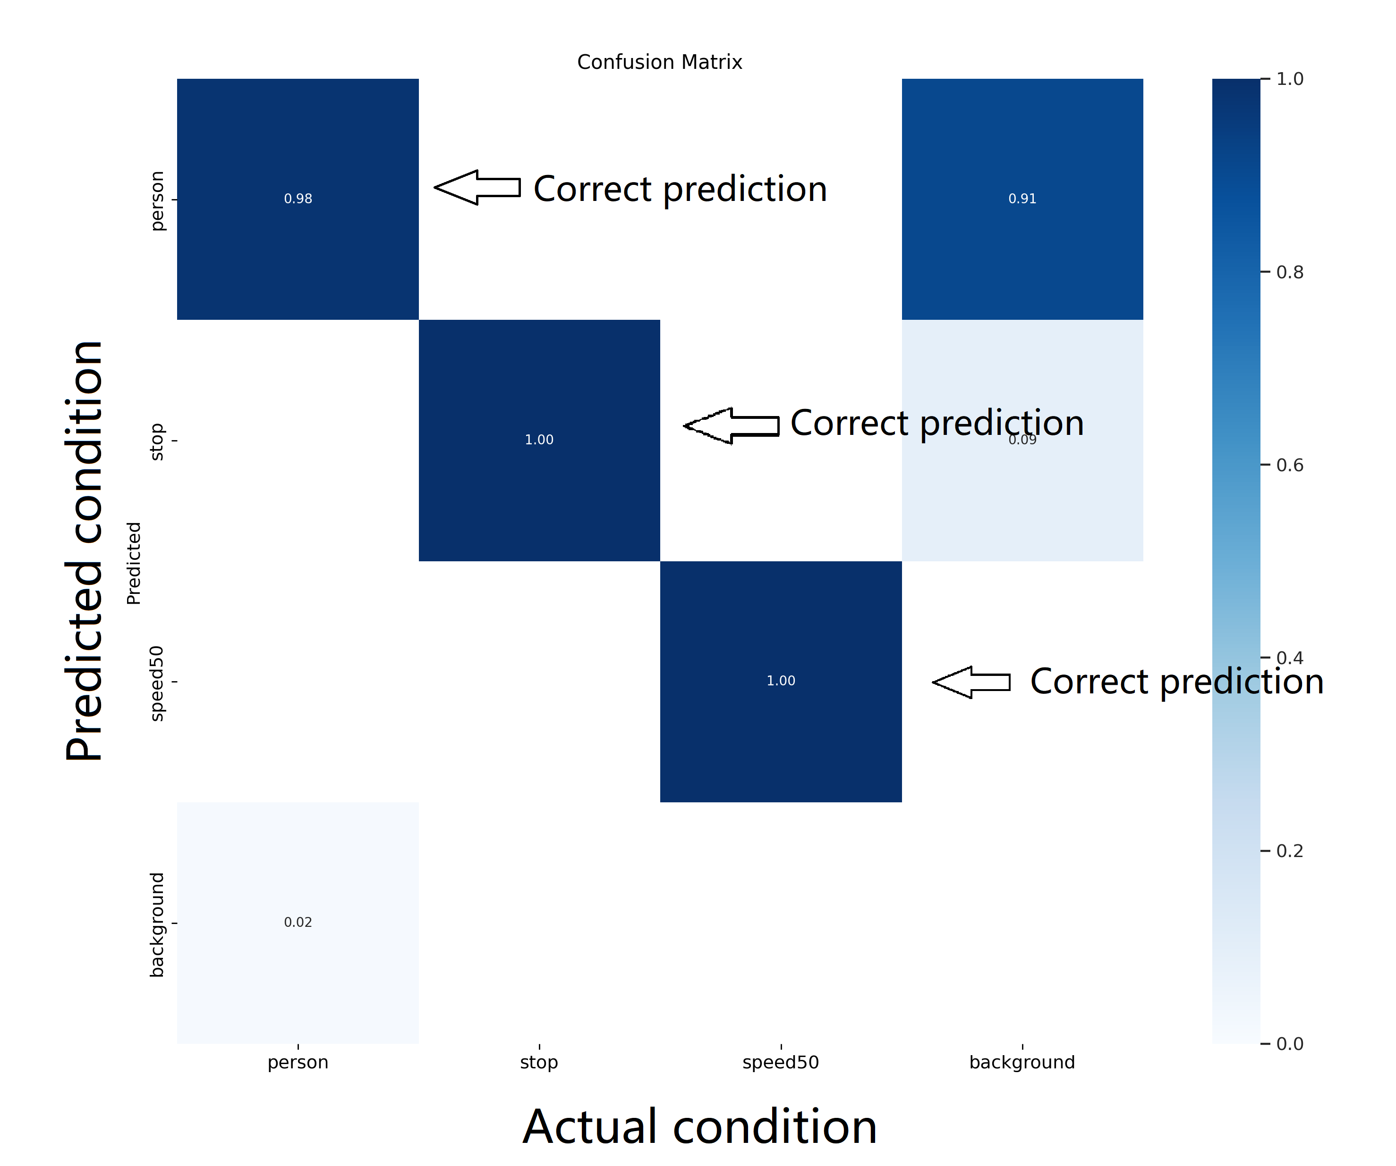
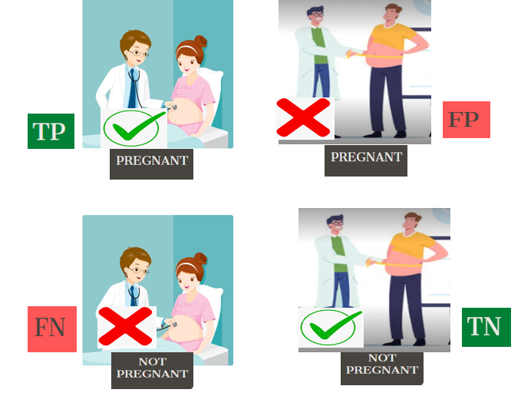
STORIES / DEMONSTRATIONS
AI training
Collect and pre-process data
Test the accuracy, recall and other indicators of the model
0.98
1.00
1.00
10
10
Notes:
Since the last column is the FP of background, which is not background, it is divided into background by pred, and the non-background objects are missed.
As the last row is background of FN, originally background, was divided into not background by pred, false detection of the original no object.

Slide 11




STORIES / DEMONSTRATIONS
Define car’s behavior according to road signs
11
11
Notes:
This story was not planned at the start of the sprint. Last week we received our road signs that you can see on this slide. Therefore, we wanted to get ahead by starting to work on sign prioritization and the car's behavior accordingly. Firstly, we thought about the behavior we wanted the car to achieve according to the road sign detected. For example, if the car sees a STOP, we want the car to go slower 5 meters before ??? And then stop next to it. And for the road sign “end of limitation” the car must recover the speed it had before the last speed sign. We thought about several possible sequences of events. ***slide***
YIELD SIGN

Slide 12

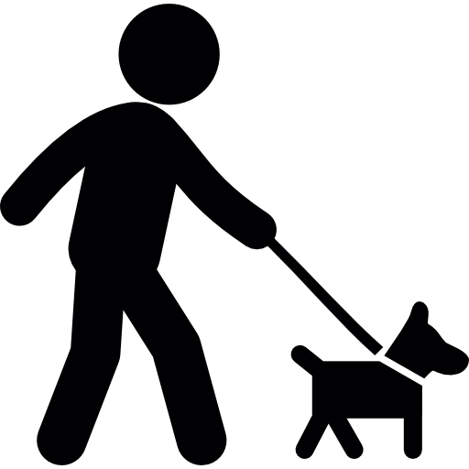

PRIORITISATION
50
STOP
30
12
Notes:
For example, we simulated this case. The car is driving at 50km/h and encounters a 30km/h speed sign. It then adjust it speed accordingly. But then, the car detects a pedestrian. The car stops and when the pedestrian is gone the car recovers its last speed. Same happens with the STOP sign and after waiting two seconds, the car moves forward again and when encountering the end of limitation sign recovers the speed of 50km/h. For now, we've only just begun to write some code that we will improve in a future sprint.

Slide 13
ORGANIZATION OF SPRINT 2
NOVEMBER
15 | 16 | 17 | 18 | 19 | 20 | 21 | 22 | 23 | 24
25 | 26 | 27 | 28 | 29
First week
Second week
Jetson Configuration
US detection
Event prioritization
Search Dataset
Coco to Yolo
AI training
Priority tasks
13
13

Slide 14


SCHEDULE CONTROL
NOT PLANNED BUT DONE
• Prioritizing messages with detection
• Pedestrian detection using AI models
PLANNED
• Train AI Model with road sign dataset
• Road sign detection using AI models
• US detection of obstacles
DONE
• Train AI Model with stop and speed sign
• Stop sign detection using AI models
• US detection of obstacles
PLANNED BUT NOT DONE
• Use Jetson to run AI models
14
14

Slide 15



OBJECTIVES OF SPRINT 3
Car behavior implementation
Implement previously defined behaviors
New road signs detection
Find and add other datasets for speed limits and speed bump
Link Camera detection to car behavior
Ensure communication between Jetson and Raspberry without computer
15
15
Notes:
For sprint 3, we have 3 main goals. First, we want to implement the car behavior Lea talked about earlier so that we can simulate the car reaction to each road sign.
We will also work on detecting new road signs, and improving the datasets.
Finally, we want our camera detection to communicate directly with the car without using our PC

Slide 16

OBJECTIVES OF SPRINT 3
User Story 1: Adapt car behavior to various road signs
Implement previously defined behaviors
Calculate car traveled distance
Tests:
Simulate various road scenarios
Ensure the car respects our operational requirements
Calculate the distance between the car and detected road sign
16
16
Notes:
Our first user story is for the car to adapt its behavior based on the detected sign. Like lea said earlier, we already defined those on paper, and we now have to implement them.
To do so, we will need to calculate the distance between the car and the sign when it is detected because we don’t want the car to react 10 meters before the sign. For the same reason, we will have to calculate the distance traveled by the car once an information is received to ensure it ract in time. For exemple, in the speed bump case, the car will halves its speed only for three meters, so we need to measure this distance.
At the end of the sprint, we will be able to simulate a road sign detection, and the car will have to react the intended way. We will ensure the dsitnaces, and time planned, are all respected.

Slide 17


OBJECTIVES OF SPRINT 3
User Story 2: Improve road signs detection using AI models
Find, create or improve datasets for speeds and speed bump road signs
Ensure mixing road signs does not impact negatively the accuracy
Train AI models
Test:
• Ensure a 95% accuracy
• Place different road signs on the road and observe the behavior of the car after detection
17
17
Notes:
As a second user story, Yuchen and Sarah will work on improving our road sign detection. To do so, they will look for new datasets to include new road signs such as the speed bump one. They will also improve our already started AI model for speed signs, which does not work with the wanted accuracy. Given our AI model were not trained on the same dataset, we will then ensure there is no road sign mix up.
At the end of the sprint, we want to have a 95% accuracy, and we will test the good detection in the same way we did today with the stop sign and verifying the car behavior is the good one.

Slide 18

OBJECTIVES OF SPRINT 3
User Story 3: Link camera detection and behavior of the car using the car's hardware
Use Jetson for AI detection
Create ROS node with yolo
Communication between Jetson and Raspberry
18
18
Notes:
Finally, Luiz will work on the communication between the camera and the car without using an aditionnal computer.
At the end of the sprint, it will be seen in our demonstrations that we don’t need another computer, and no actions are required from us.

Slide 19
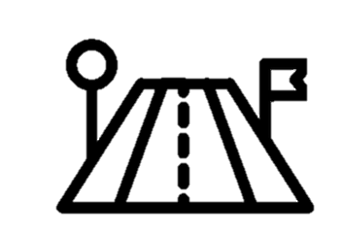

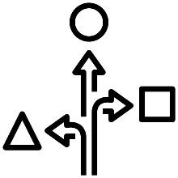
SUMMARY
Sprint 2:
Sprint 3:
AI training and detection
Adapt car behavior
Obstacles detection
with sensors
New road signs detection
Link camera detection and behavior
Behavior Description
19
19
Notes:
So, to sum up the matter, during this sprint we succeeded in creating our first AI model and training it with stop sign and pedestrians. We also used ultrasonic sensors to detect additional pedestrians. Finally, we planned our entire car behavior by taking in account multiple scenarios.
For the next sprint, we will implement this behavior, add new sign detection, and link the camera detection with the car behavior.

Slide 20
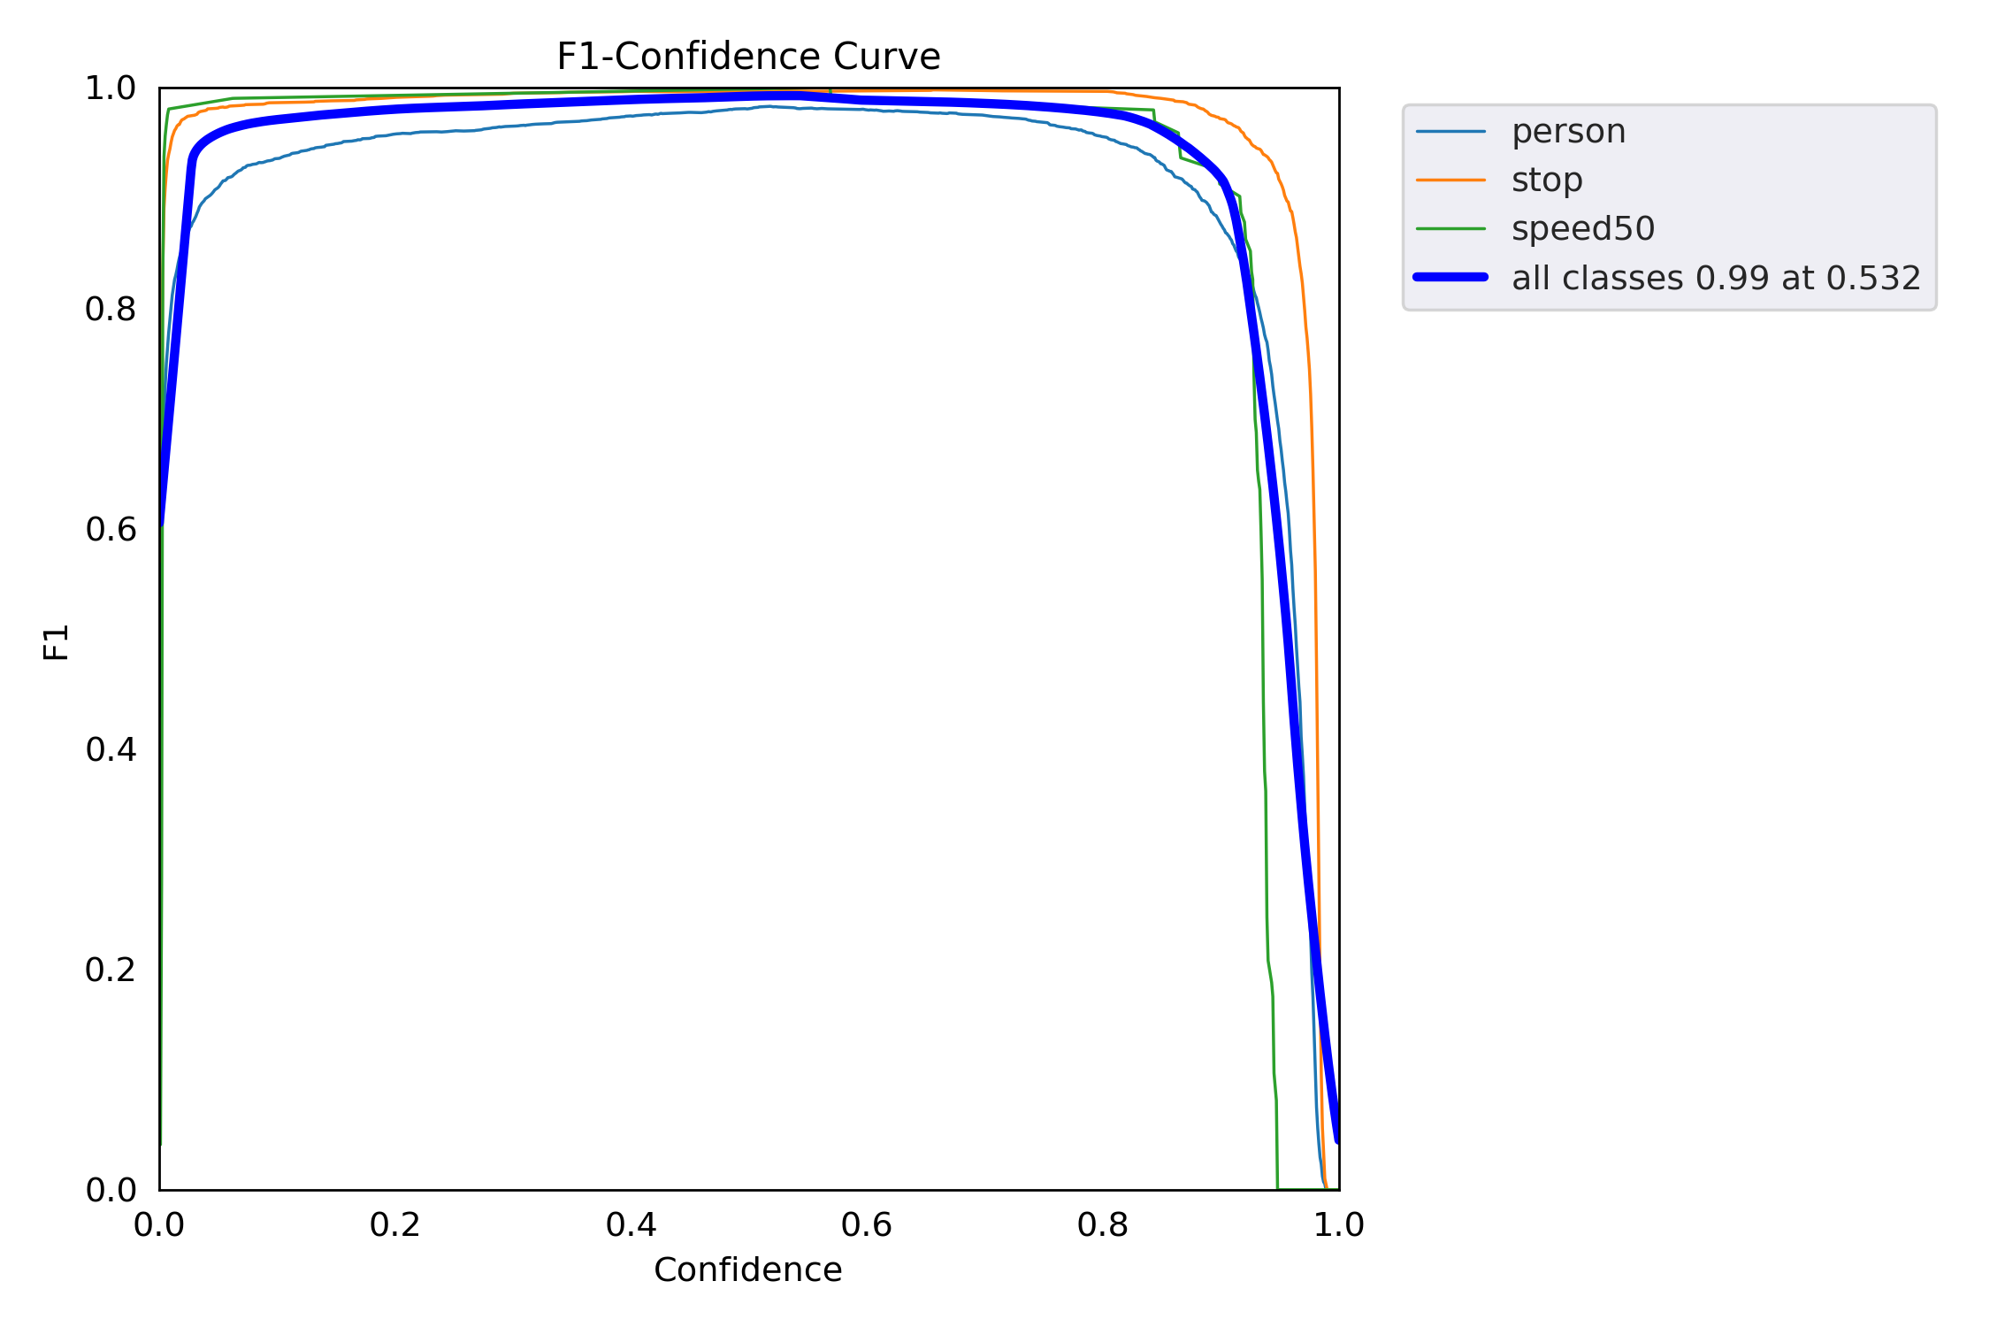
STORIES / DEMONSTRATIONS [3/3]
AI training
Collect and pre-process data
Test the accuracy, recall and other indicators of the model
20
20
Notes:
mAP stands for Mean Average Precision. As you can see: the higher the precision, the lower the recall.
But we want our network, with a high accuracy, to detect all the categories as much as possible. So we want our curve to be close to the (1, 1) point, i.e. we want the area of the mAP curve to be as close to 1 as possible.

